Slide 1
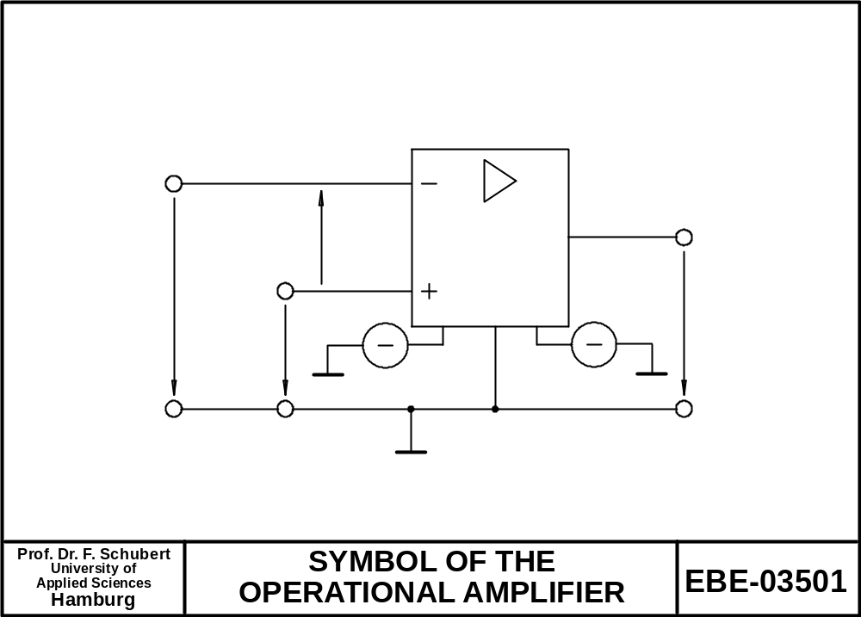
V_{d}
V_{N}
V-
GND
V+
V_{out}
V_{P}
-V_{B}
+V_{B}

Slide 2
Videos
http://www.youtube.com/watch?v=icFo5Zeydqg&feature=related | 16 minutes, focus on comparators / schmitt trigger
http://www.youtube.com/watch?v=iItYjrScGqU |  |  | 10 Minutes, incl. Vdd limit, complex circuit in feedback path
http://www.youtube.com/watch?v=TQB1VlLBgJE |  |  | 5 minutes, Mikrophone amplifier, little theory, cat noise, 5 min

Slide 3
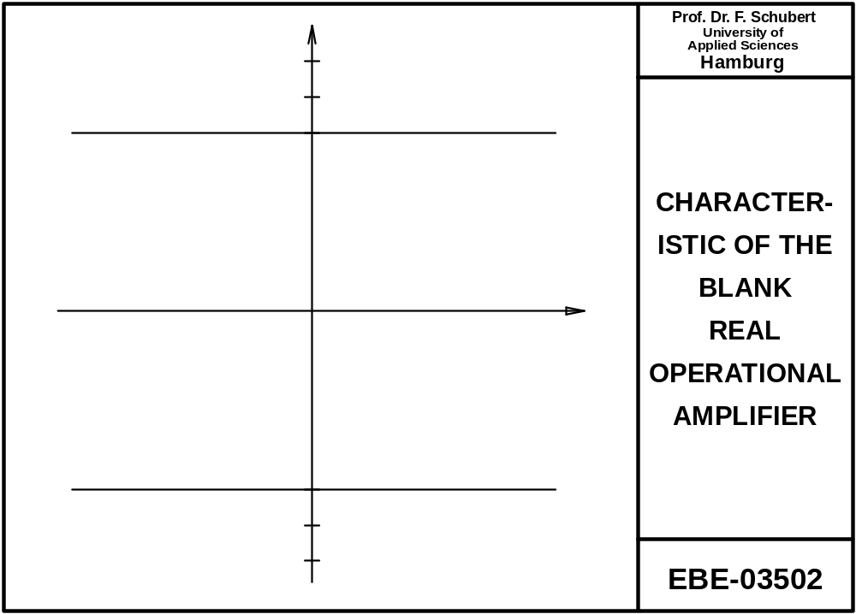
V+
V_{max}
V_{d}
V_{OS}
V_{min}
V-

Slide 4
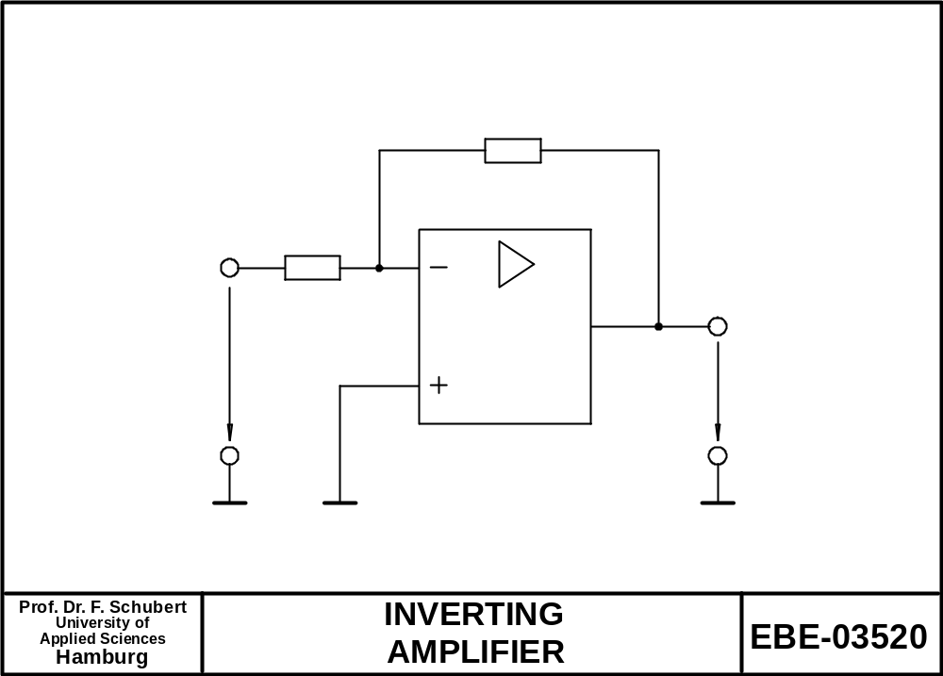
R_{A}
R_{E}
V_{d}
V_{E}
V_{A}

Slide 5
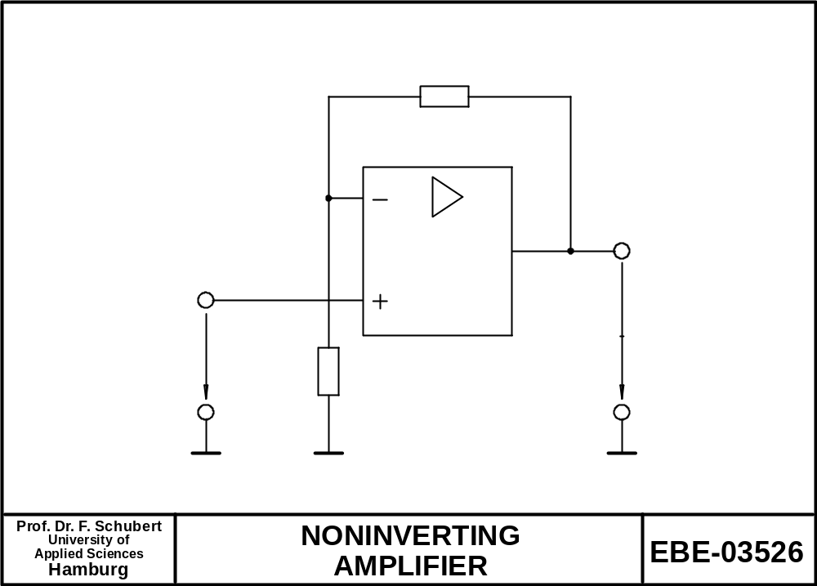
R_{A}
V_{d}
V_{A}
V_{E}
R_{E}

Slide 6
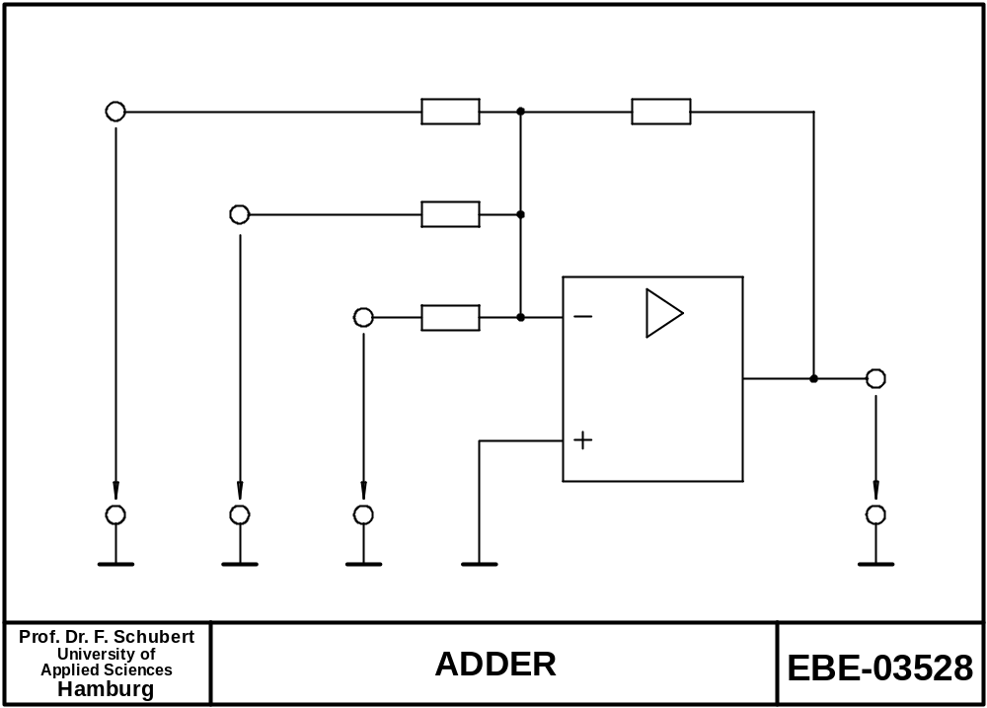
R_{E1}
R_{A}
R_{E2}
R_{E3}
V_{E1}
V_{E2}
V_{E3}
V_{A}

Slide 7
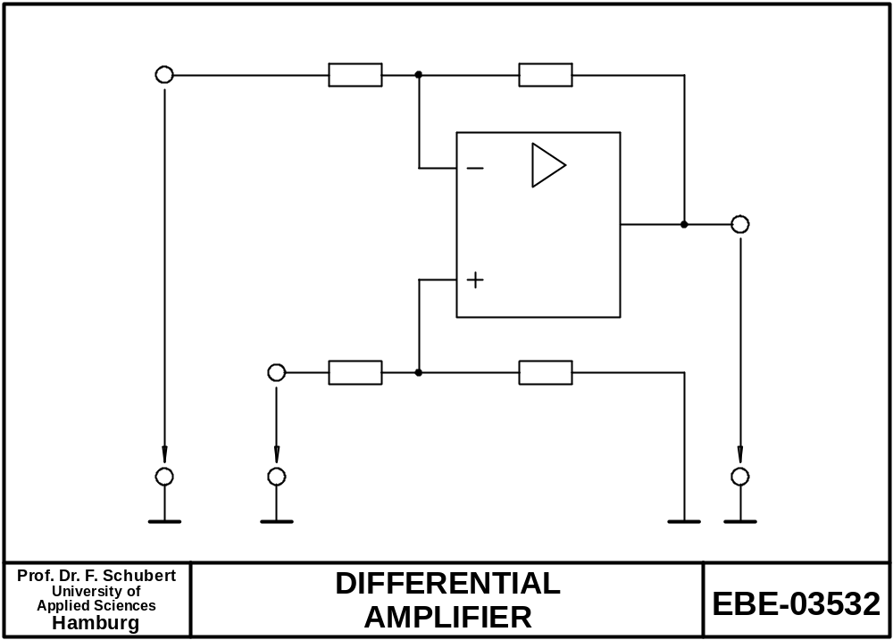
R_{E1}
R_{A1}
V_{E1}
R_{E2}
R_{A2}
V_{A}
V_{E2}

Slide 8
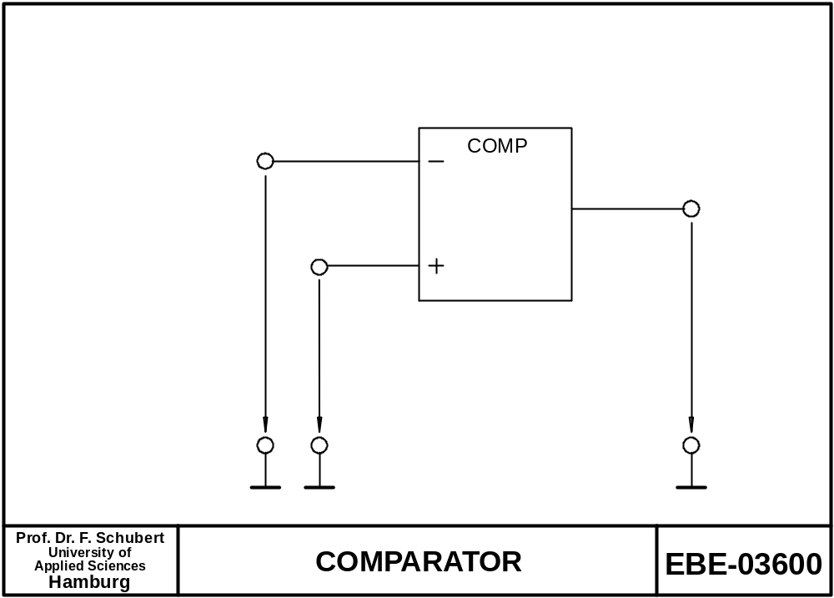
V_{E1}
V_{Q}
V_{E2}

Slide 9
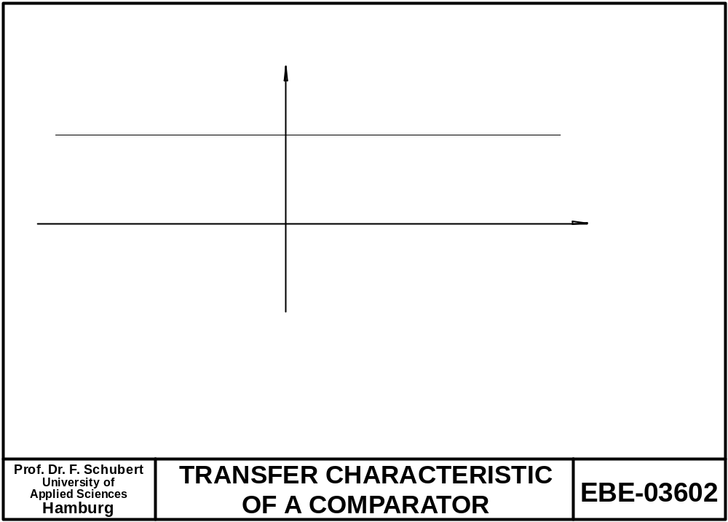
V_{Q}
V_{E2} -V_{E1}

Slide 10
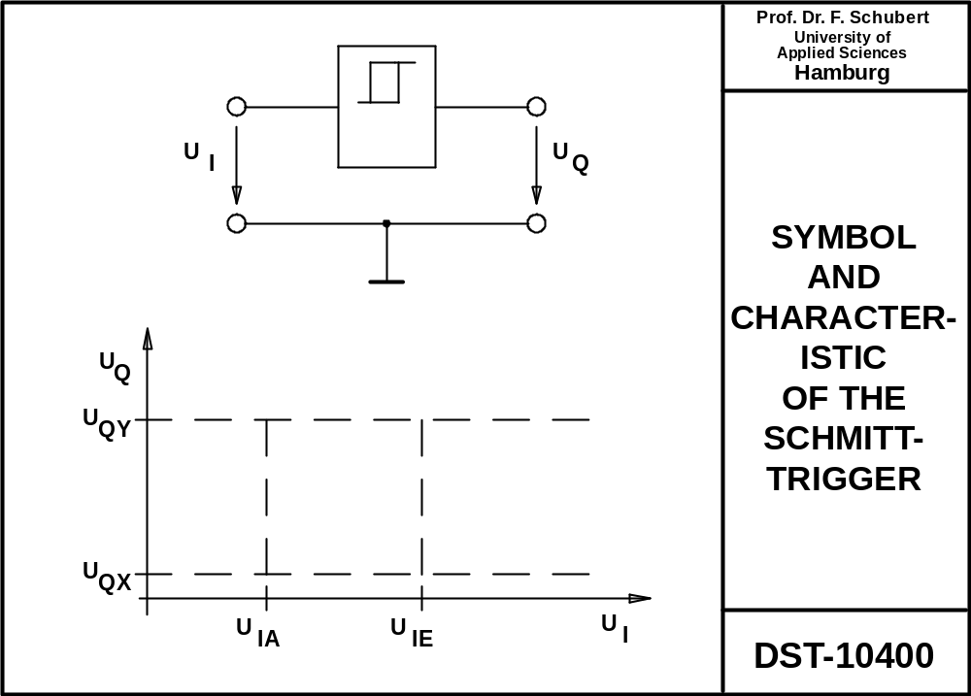

Slide 11
